Slide 1

FitFuel
Discover a
Healthier You
TEAM 7
Vishnu Hidesh
Amith E K
Sharun T N

Slide 2
FitFuel
Discover a
Healthier You
TEAM 7
Vishnu Hidesh
Amith E K
Sharun T N

Slide 3


WHAT IS
FITFUEL?
FitFuel is a smart website that helps you eat healthier. It uses clever technology to recognize the food you're eating and tells you how good it is for you. It also gives you advice on what to eat based on how healthy you want to be. It's like a friendly guide to better eating and living well.
FitFuel is like having a nutrition expert in your pocket. This web application is designed to simplify healthy eating. With its advanced food recognition AI, it can quickly figure out what you're eating and tell you its nutritional value. It goes beyond that – it provides tailored diet suggestions based on your health objectives. Whether you're looking to lose weight, maintain your fitness, or simply eat better, FitFuel is there to guide you every step of the way.

Slide 4

OBJECTIVES OF FITFUEL
Effortless Nutrition Tracking
Holistic Health Assessment
Personalized Wellness Journey
Achieve Health Goals
Accurate Nutritional Insight
Tailored Progress Tracking

Slide 5

MOTIVATION FOR FITFUEL
Growing health awareness
Time constraints and busy lifestyles
Complexity of nutrition information
Diverse dietary preferences
Inaccuracies in existing solutions
Advancements in AI and technology

Slide 6
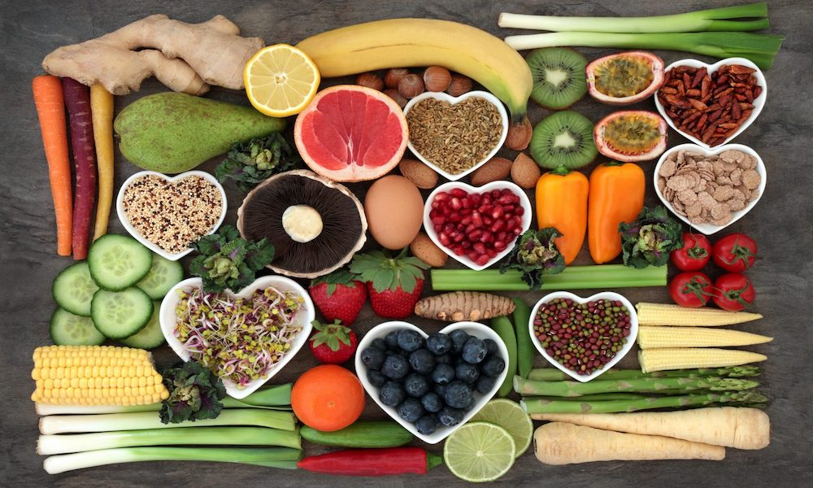
LIMITATIONS OF EXISTING SYSTEMS.
Fragmented Solutions: Many apps focus on only one aspect, such as food tracking or health assessment, leaving users to manage multiple platforms for a complete health picture.
Inaccurate Tracking: Existing food recognition systems may struggle to accurately identify foods and portions, leading to imprecise nutritional tracking.
Generalized Recommendations: Common platforms offer generic diet advice that doesn’t consider individual health conditions or dietary preferences.
Complex Interfaces: Some apps have complex interfaces that hinder user experience and discourage consistent usage.
Disconnected Tools: Health assessment and food tracking tools often lack integration, making it challenging to understand the relationship between dietary choices and well-being.
Data Privacy Concerns: Users may have reservations about sharing personal health data due to concerns about data privacy and security.

Slide 7
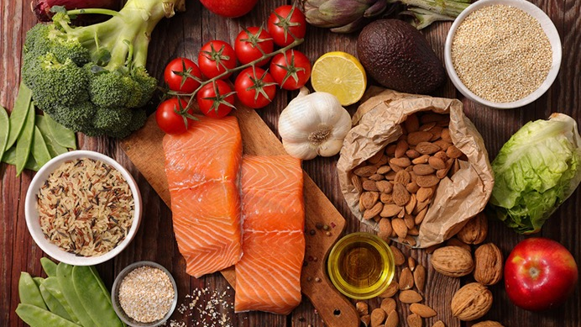
HOW FITFUEL WORKS?
Food Recognition: Users capture images of their meals using the app. The AI-powered food recognition system quickly identifies the foods and estimates their nutritional content.
Health Assessment: Users input basic health data or measurements, which are used to calculate BMI and body fat percentage. This information helps users gauge their overall health status.
Personalized Recommendations: Based on the recognized foods, health assessment results, and user preferences, the app generates personalized diet recommendations. These suggestions align with individual health goals and dietary needs.
This streamlined process empowers users to effortlessly track their nutrition, understand their health and receive tailored guidance for improved well-being.

Slide 8
APP DEVELOPMENT
Front-End : The front-end can be easily designed using HTML, CSS and JavaScript, including their common libraries and frameworks like Bootstrap, Tailwind, React.js etc.
Back-End : The back-end modular programming is wholly done using Python, and frameworks like Django or Flask can be used to implement Python in the back-end.
AI Model : The AI Food Recognition model can be trained using PyTorch, a deep learning framework of Python
This app will work operate in a web-based environment, compatible with popular web browsers, such as Google Chrome, Mozilla Firefox, Safari etc.

Slide 9
FEASIBILITY
Technical Feasibility:
AI Integration: Availability of AI tools and libraries supports the implementation of the food recognition system.
Development: The app can be developed using common programming languages and frameworks
Hardware Compatibility: Common devices with cameras enable users to capture meal images.
Operational Feasibility:
User-Friendly Design: Intuitive UI and straightforward processes enhance user experience.
System Maintenance: Regular updates can ensure smooth functioning and adaptation to new technologies.
Economic Feasibility:
Development Costs: Initial investment for software development, AI implementation, and UI design.
Maintenance Costs: Ongoing expenses for server hosting, bug fixes, and updates.
Revenue Generation: Potential revenue through premium features, ads, or subscriptions.

Slide 10
FEASIBILITY
Legal and Ethical Feasibility:
Data Privacy: Adherence to data protection regulations and user privacy concerns.
Ethical Considerations: Ensuring AI-based recommendations are unbiased and promote users’ well-being.
Market Feasibility:
Target Audience: A growing market of health-conscious individuals seeking convenient and effective health management tools.
Competitive Landscape: Analyzing existing apps reveals a demand for integrated solutions.

Slide 11
BLOCK DIAGRAM
USER INTERFACE
FOOD RECOGNITION AI
HEALTH ASSESSMENT TOOLS
USER DATA MANAGEMENT
BMI ANALYSER
FAT ANALYSER
DIET RECOMMENDATION
USER PREFERENCES
USER GOALS
DATABASE

Slide 12
FUTURE ENHANCEMENTS
Expanded Food Recognition Database:
Increase the variety of recognized foods and dishes to enhance accuracy and coverage.
Include international cuisines and unique dishes for a more diverse user base.
Advanced Health Assessment Tools:
Incorporate additional health metrics like heart rate, blood pressure, and sleep patterns for a more comprehensive health analysis.
Integrate wearable devices to automate data collection for a seamless experience.
Integration with Fitness Apps:
Collaborate with fitness tracking apps to create a unified health management platform.
Sync exercise data with dietary information to provide a holistic view of users' well-being.
Nutritional Insights and Trends:
Provide users with detailed nutritional insights based on their dietary habits over time.
Identify patterns and trends in their eating behavior to further personalize recommendations.

Slide 13
FUTURE ENHANCEMENTS
Social and Community Features:
Introduce social features, allowing users to connect, share progress, and exchange healthy recipes.
Create a supportive community for motivation and accountability.
AI Refinement and Learning:
Continuously improve the food recognition AI through machine learning and user feedback.
Enhance the accuracy of nutritional estimations and portion sizes.

Slide 14
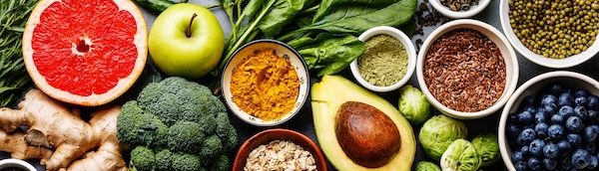
A HEALTHIER AND FIT WORLD
We invite you to join us on this journey.

Slide 15
FitFuel
Discover a Healthier You

